Slide 1
The forgotten sixth sense and it’s role in Functional Neurology and neurorehabilitation
Thomas van den Hof
Igor Dijkers
Sweden, April 2024

Slide 2
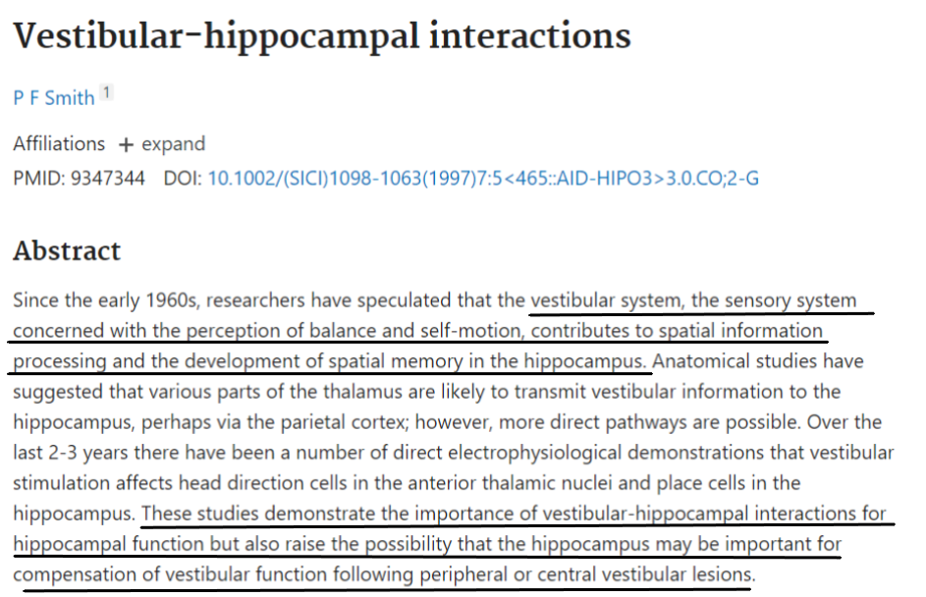
Thomas van den Hof
Igor Dijkers
Sweden, April 2024

Slide 3
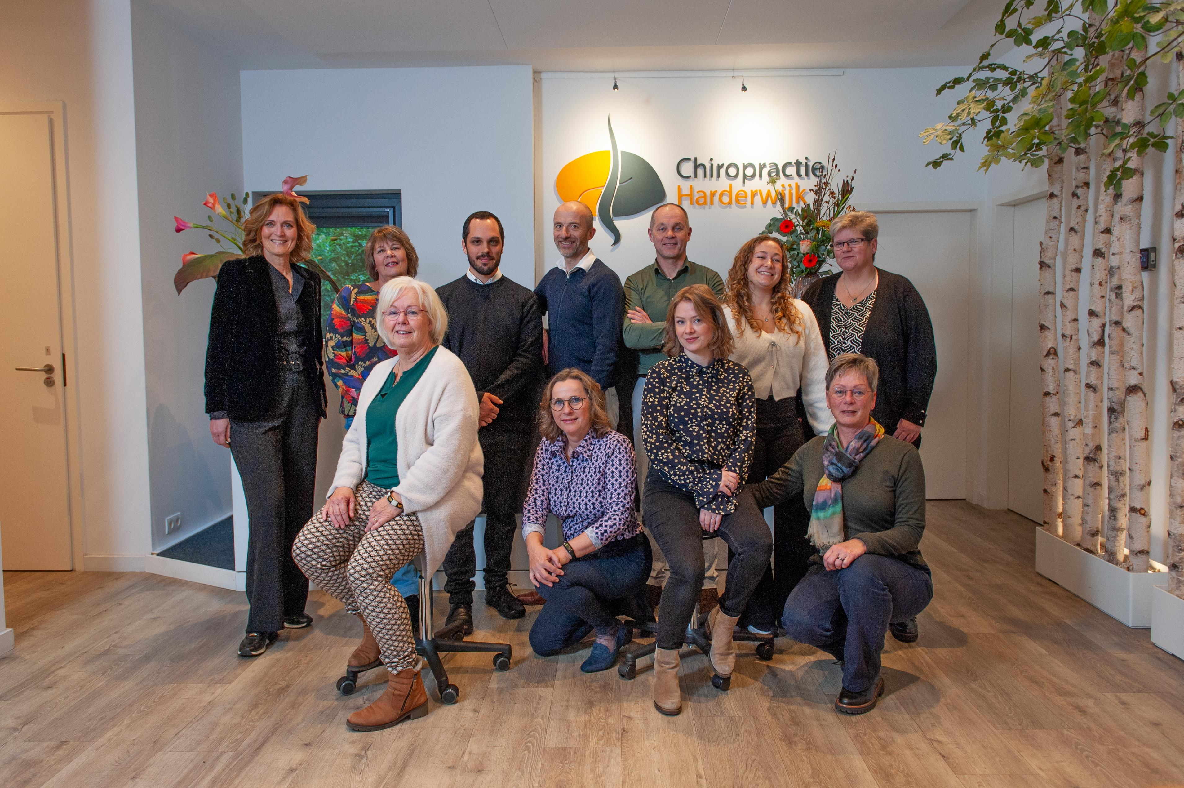
Chiropractic & Functional Neurology
Neurodevelopmental problems: www.neuro4kids.nl
Concussion, dystonia and other brain-based problems: www.verbeterjebrein.nl
MSK disorders: www.chiropractieharderwijk.nl
Notes:
Learned bascis
Worked as a chiropractor, Looking at pupils

Slide 4
Case
“Will you help me read a little better?”

Slide 5
Content
Functional neurology – an introduction
Basics of the vestibular system
Vestibular system: beyond balance
Practical demo
Vestibular and oculomotor evaluation
Positional testing and repositioning
Vestibular ocular rehabilitation exercises

Slide 6
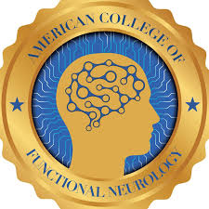
What is Functional Neurology
“A health care specialty and a field of study that focuses on assessing and quantifying neurological activity and utilizes sensory, motor, and cognitive evoked potentials, and in some cases nutrients and pharmacotherapy, to promote normalization and optimization of neurological function”
www.acfn.org
Notes:
Functional neurology is a powerfull thoughtproces. It uses neuro physiology or pathophysiology as an entrance for therapy or performance enhancement.
All sensors and interconnections can be used as a therapeutic application.
Integration of the neuronal networks is keys.
Why do we need FN? How can it help?

Slide 7
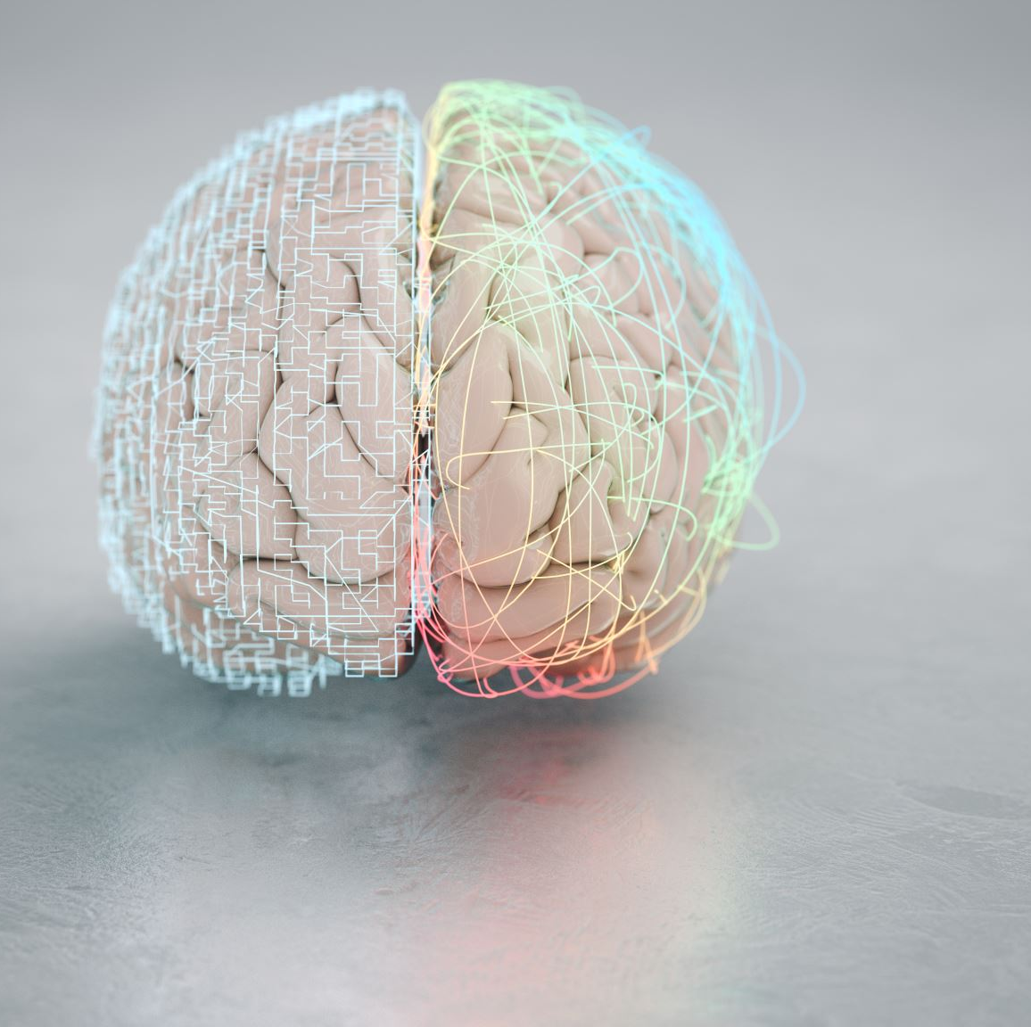
How can functional neurology help?
Are we using sensors of the body?
Do those sensors have an effect in the brain?
Does this effect alter brain output (i.e. movement)
Can a muscle work on its own?

Slide 8
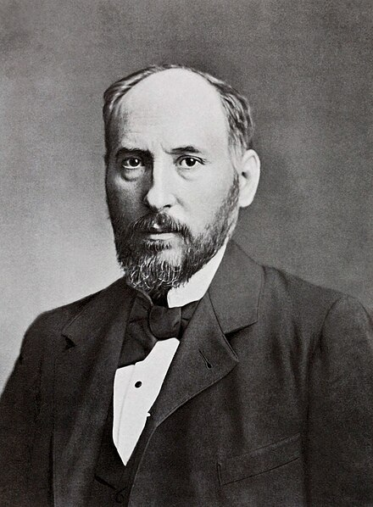
Functional Neurology – the very basics
Santiago Ramón y Cajal
Neuron theory
Central integrative state
Summation
Metabolic capacity

Slide 9
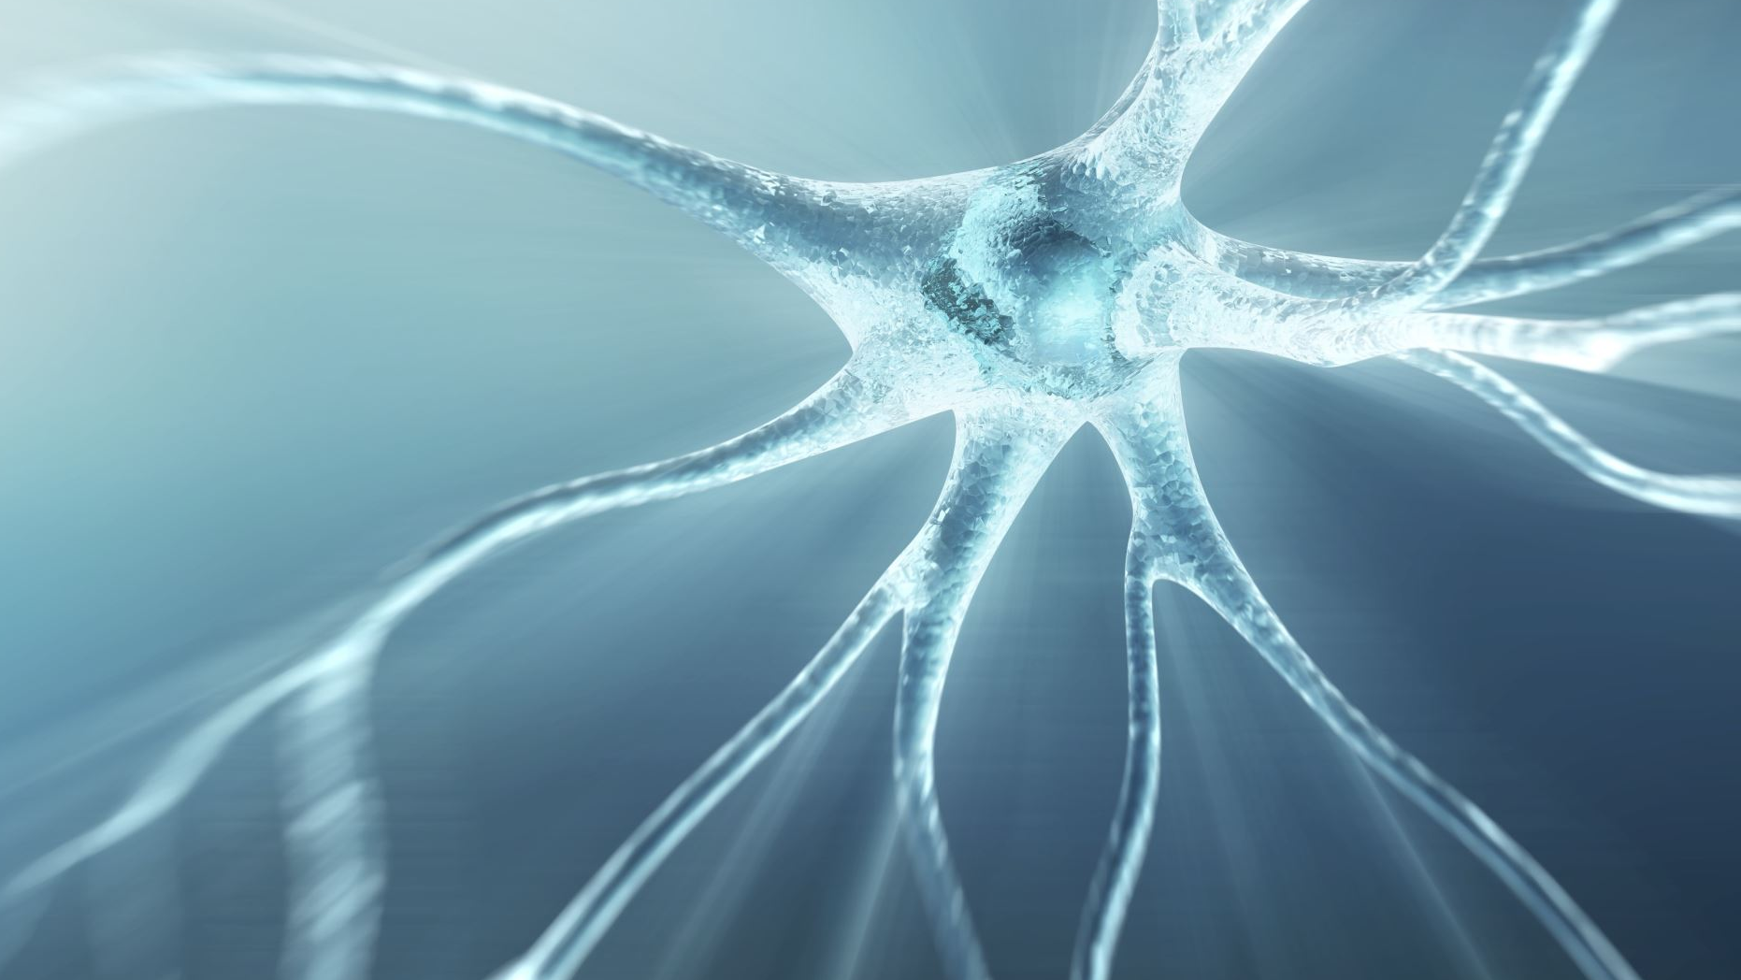
Neuron theory The basics of Functional Neurology

Slide 10
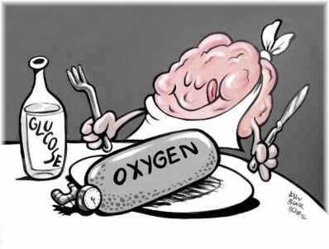
Neuron theory
Each neuron needs:
Oxygen
Nutrients
And...

Slide 11
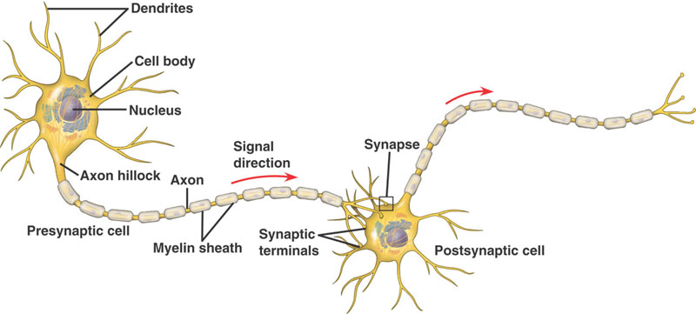
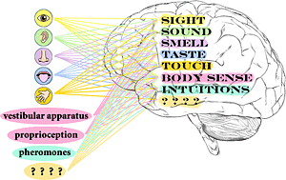
…Stimulus
Through our sensory receptors
From other neurons
inhibitory or
excitatory

Slide 12
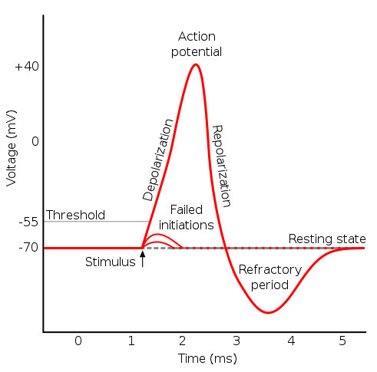
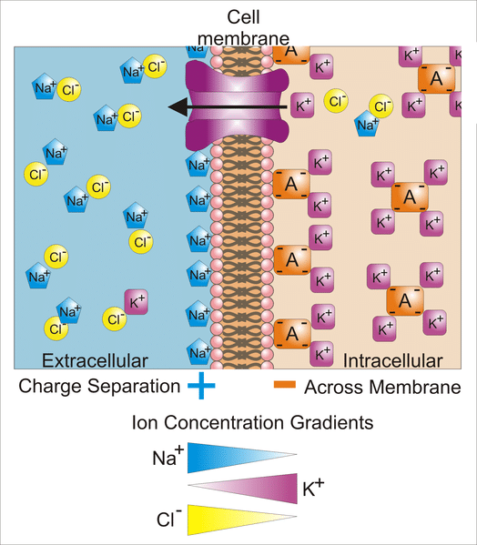
…Stimulus creates;
Changes in membrane potential.
Keeps metabolism healthy….or not!

Slide 13
Central integrative state (CIS) of a neuron
The capacity of a neuron to generate an apropriate action potential (based on the integrated input it receives)
It should not fire when overall stimulus is too low
It should be able to sustain firing if it receives corresponding input
Notes:
General fitness it you like
Balance between activation and inhibition
How well tolerates the neuron stimulus or inhibition.
Example: matrathon runner or body builder
.

Slide 14
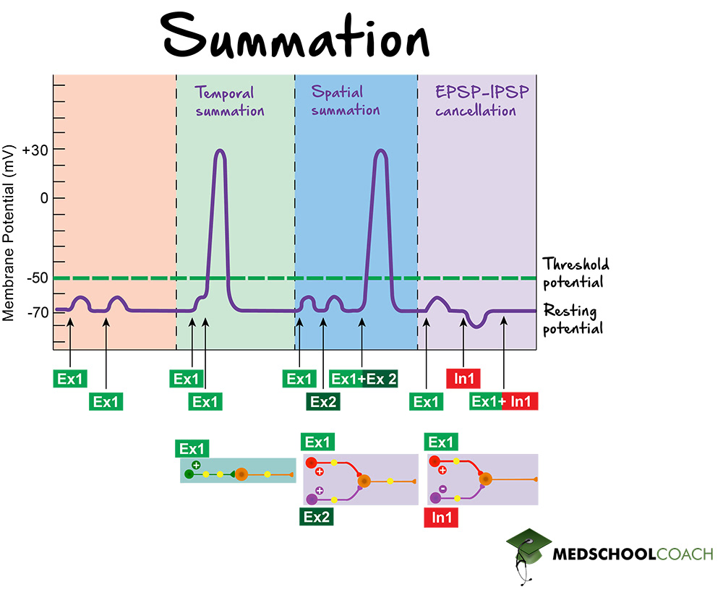
CIS = Summation

Slide 15
CIS of a functional unit
“Central Integrative State” applied to a group of neurons e.g.:
Nucleus in the brainstem Midbrain, Vestibular nuclei
Specific part of the cerebellum Dentate, Emboliform, Globose
Specific cortical area area Basal Ganglia, Thalamus
Taylor DN. The Neurophysiological Lesion: A Scoping Review. J Chiropr Med. 2023 Jun;22(2):123-130
Allen M & Rosner AL The mechanism of manual muscle testing as proposed by the ventral horn theory. Medical hypotheses 2024: 182: 111240
Notes:
Neuron theory adapted to Neuronal networks.

Slide 16
Metabolic capacity
The cellular health of a neuron
Capable of dealing with stimuli
Sufficient and correct protein production
If stimulus load is too high: metabolic capacity is exceeded
Potential neuronal death
Notes:
Nutritional status
How well can it tolerate stimuli.

Slide 17
Metabolic capacity: limitations in recovery
Oxygen:
Anemia
Lung disease
Allergies/smoking
Heart disease
Deficiencies
Glucose and nutrients:
Diabetes
Medication
Malabsorption
Nutrition
Supplements
INFLAMMATION
&
EXCITOTOXICITY

Slide 18
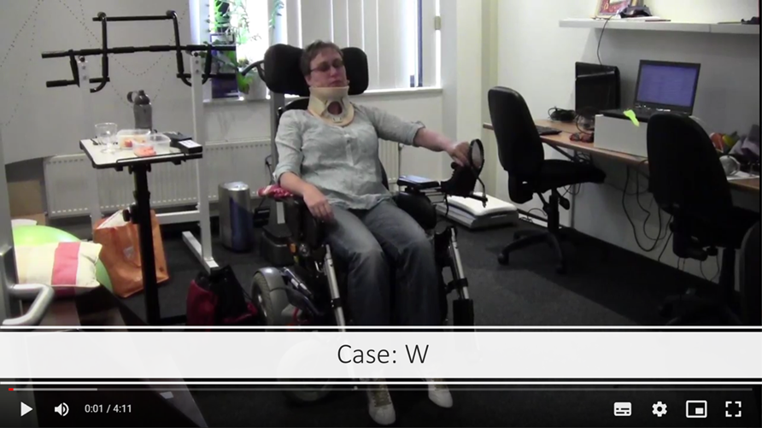
Back to the case
Activation/stimulus (Neuron theory)
Gabapentin
Oxazepam
Diazepam
Sarotex
Paracetamol
Omeprazol
Eyes
Ears
Muscles
Nutritional status (CIS)
Gut issues
Medications (Metabolic capacity/ limitations)
Notes:
Does her nutritional status matter?

Slide 19
Vestibular system
The forgotten and sixth sense
You don’t realize its importance until it dysfunctions
What would you be without?
Vestibular information spreads to many parts of the central nervous system having wide ranging effects on different systems
Essential in Functional Neurology

Slide 20
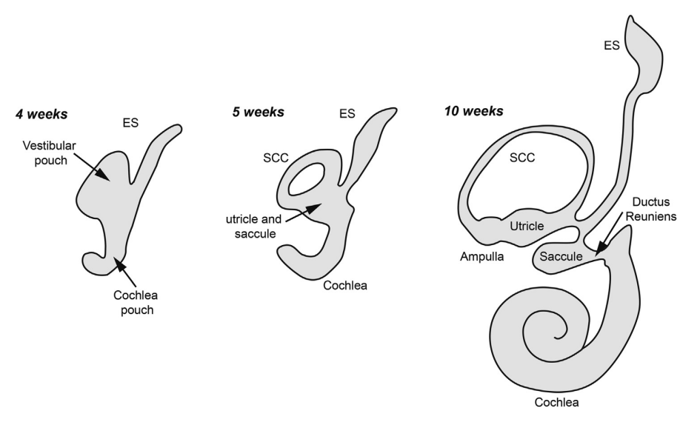
Basics of Vestibular System
The most ancient sensory system in vertebrates
The first sensory system that is developed in embryology
The “balance” system
Božanić Urbančič, N., Battelino, S., & Vozel, D. (2023). Appropriate Vestibular Stimulation in Children and Adolescents—A Prerequisite for Normal Cognitive, Motor Development and Bodily Homeostasis—A Review. Children, 11(1), 2.
Lim R, Brichta AM. Anatomical and physiological development of the human inner ear. Hear Res. 2016 Aug;338:9-21.

Slide 21
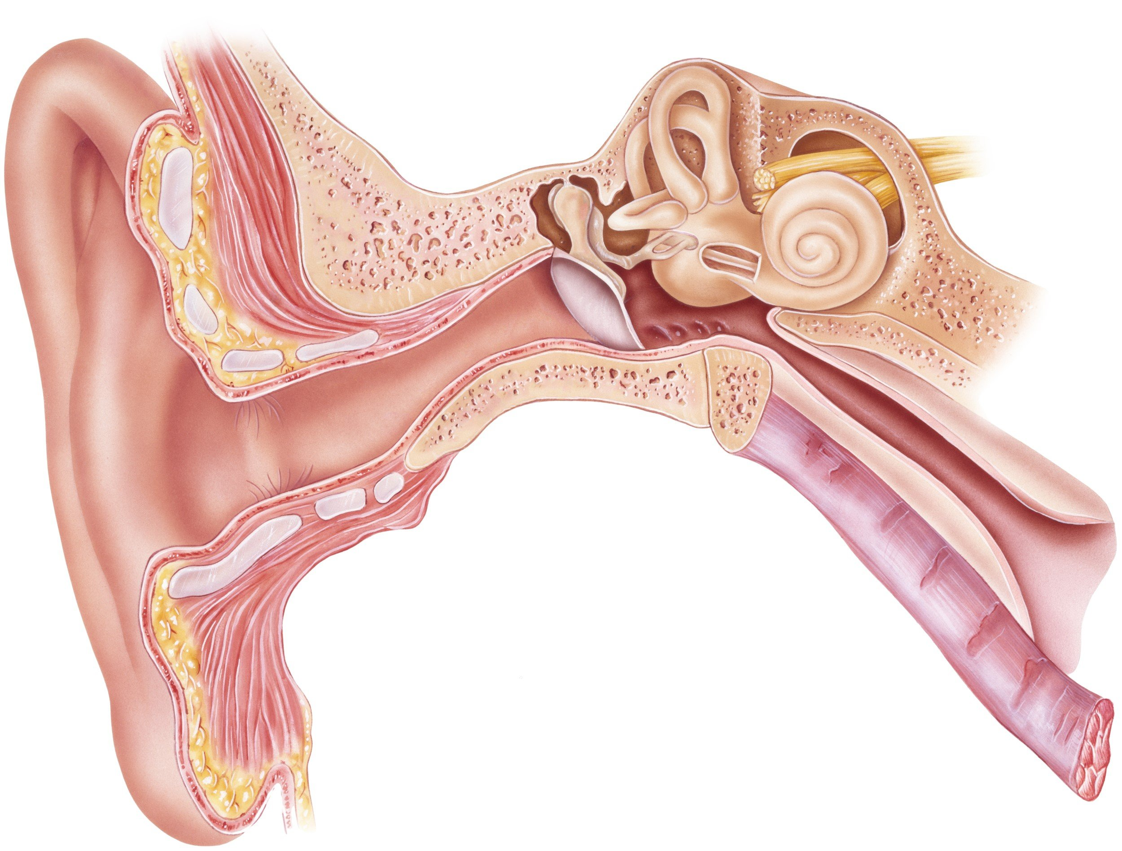
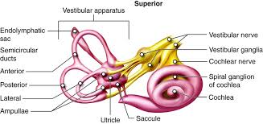
Basics of Vestibular System
Accelerations/decelerations/ Gravity
Semicircular canals
Otolyths (Utricle and Saccule)
Notes:
Push-pull mechanism
Fluid motion based
Vestibular nerves

Slide 22
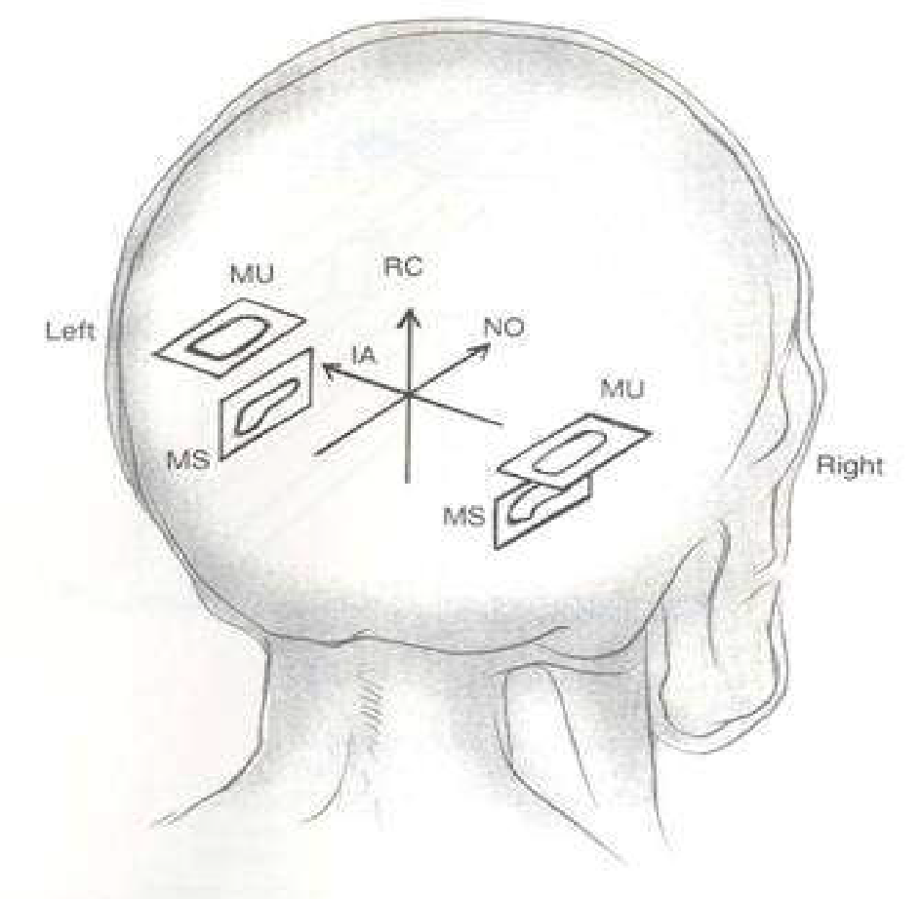
Basics of Vestibular System
Otolyths:
Linear accelerations/decelerations
Gravity
Utricle
Saccule
Notes:
Push-pull mechanism
Fluid motion based
Vestibular nerves

Slide 23
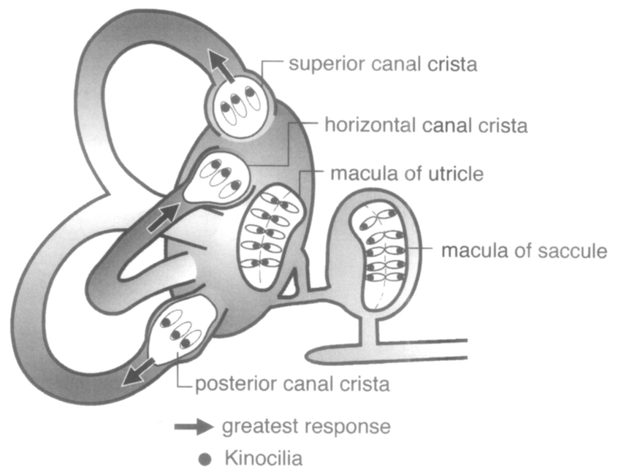
Basics of Vestibular System
Semicericular canals:
Rotational accelerations/decelerations
Notes:
Push-pull mechanism
Fluid motion based
Vestibular nerves

Slide 24
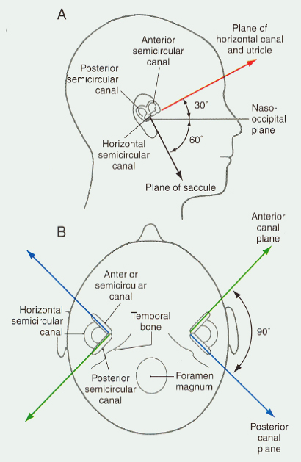
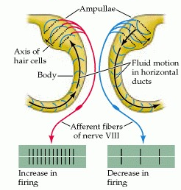
Basics of Vestibular System
Semicircular canals:
accelerations/decelerations
Anterior
Posterior
Horizontal
Notes:
Push-pull mechanism
Fluid motion based
Vestibular nerves

Slide 25
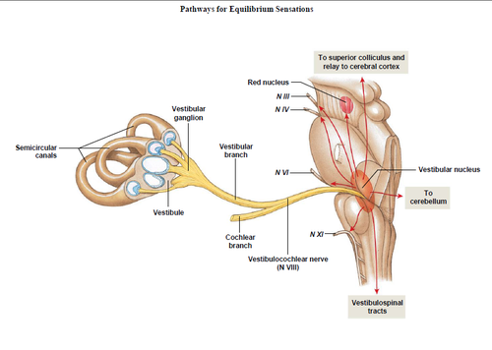
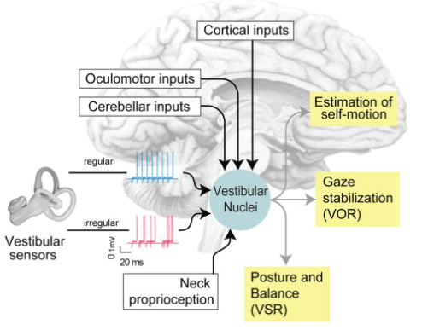
The Vestibular nuclei - input
Cullen KE. The vestibular system: multimodal integration and encoding of self-motion for motor control. Trends Neurosci. 2012 Mar;35(3):185-96.

Slide 26
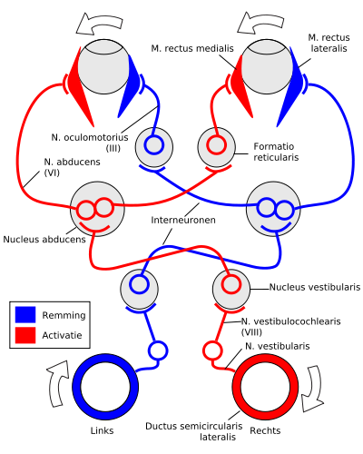
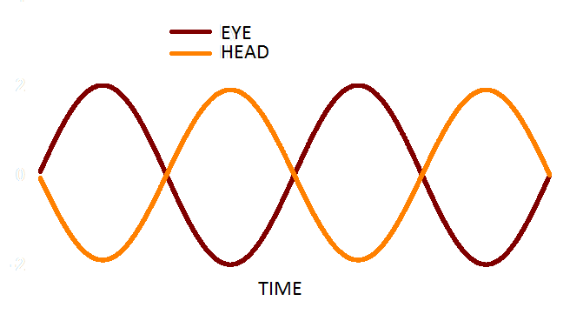
Vestibular Based Reflexes
VOR: Gaze stability
VSR: Postural stability
VCR: Head stability
Notes:
VSR: via lateral VN (Deiter’s) and lateral vestibulospinal tract: C5-L1 ipsilateral; extensors of arms, back and proximal legs
VCR: via medial VN and medial vestibulospinal tract. Bilateral projections C1-4

Slide 27
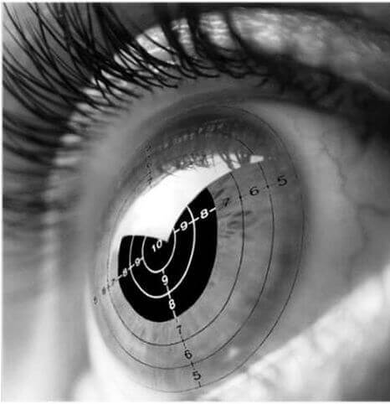
VOR: Gaze stability
Stabilisation of images on the retina (gaze) during head movement.
Very fast: < 10 ms reflex
‘3 neuron arc’.
Self stationary, moving object
self moving, stationary target
self moving, moving object.
Notes:
VSR: via lateral VN (Deiter’s) and lateral vestibulospinal tract: C5-L1 ipsilateral; extensors of arms, back and proximal legs
VCR: via medial VN and medial vestibulospinal tract. Bilateral projections C1-4

Slide 28
VSR: Postural stability
Lateral Vestibulo-spinal tract
Excites extensors and anti-gravity muscles
Notes:
VSR: via lateral VN (Deiter’s) and lateral vestibulospinal tract: C5-L1 ipsilateral; extensors of arms, back and proximal legs
VCR: via medial VN and medial vestibulospinal tract. Bilateral projections C1-4

Slide 29
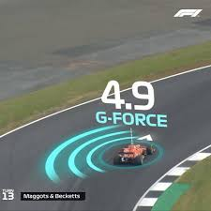
VSR: Head stability
Medial Vestibulo-spinal tract
Excites neck musculature
Notes:
VSR: via lateral VN (Deiter’s) and lateral vestibulospinal tract: C5-L1 ipsilateral; extensors of arms, back and proximal legs
VCR: via medial VN and medial vestibulospinal tract. Bilateral projections C1-4

Slide 30
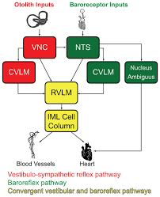
VSR[2]: autonomic stability
Vestibulo-sympathetic tract
Modulates bloodpressure
Notes:
VSR: via lateral VN (Deiter’s) and lateral vestibulospinal tract: C5-L1 ipsilateral; extensors of arms, back and proximal legs
VCR: via medial VN and medial vestibulospinal tract. Bilateral projections C1-4

Slide 32
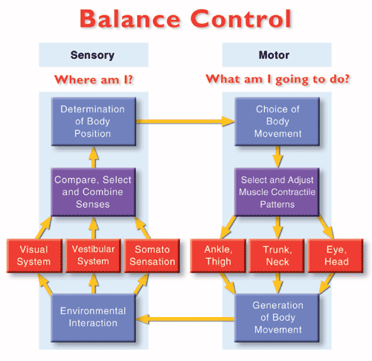
Autonomic system
Autonomic system

Slide 33
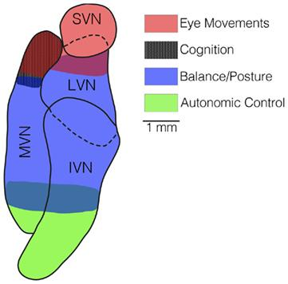
Vestibular Based dysfunctions
Visual problems
Spinal problems
Balance problems
Autonomic problems
Orientation issues
And more….
Can be do anything about this?
Notes:
VSR: via lateral VN (Deiter’s) and lateral vestibulospinal tract: C5-L1 ipsilateral; extensors of arms, back and proximal legs
VCR: via medial VN and medial vestibulospinal tract. Bilateral projections C1-4

Slide 34
Vestibular System: influences beyond balance
“The vestibular system can serve as a promising area to investigate brain function beyond balance maintenance, extending into realms of cognition, emotion and psychiatric symptoms “
Lacroix E, Deggouj N, Edwards MG, Van Cutsem J, Van Puyvelde M, Pattyn N. The Cognitive-Vestibular Compensation Hypothesis: How Cognitive Impairments Might Be the Cost of Coping With Compensation. Front Hum Neurosci. 2021 Oct 1;15:732974

Slide 35
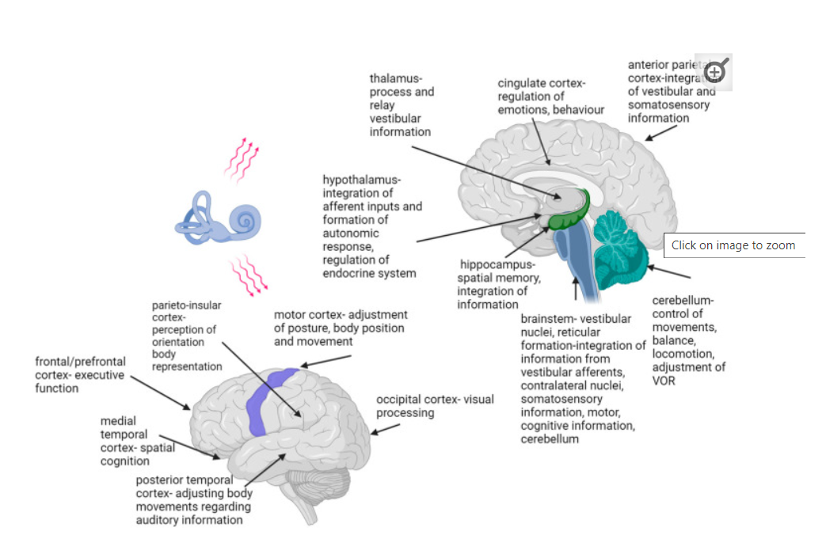
Vestibular system-associated network
Involved areas:
(Pre)frontal cortex
Motor cortex
Parieto-insular cortex
Parietal cortex
Temporal cortex
Occipital cortex
Cingulate cortex
Hypothalamus
Hippocampus
Cerebellum
Brainstem
Božanić Urbančič, N., Battelino, S., & Vozel, D. (2023). Appropriate Vestibular Stimulation in Children and Adolescents—A Prerequisite for Normal Cognitive, Motor Development and Bodily Homeostasis—A Review. Children, 11(1), 2.
Notes:
Vestibular system: the only sensory system whose information is not directed to a single and specific brain area

Slide 36
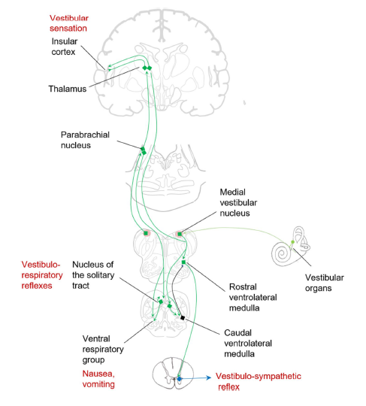
Vestibulo-autonomic relations
Dizziness:
Vertigo “spinning”
(Classically related to vestibular problems)
Lightheadedness
Pre-syncope (about to faint)
Unsteadiness
Bogle JM. The role of otolith reflexes in orthostatic intolerance. Clin Auton Res. 2022 Dec;32(6):395-398
Notes:
As gravito-inertial accelerometers, the otolith organs are likely to provide key information regarding changes in head and body position through identification of linear acceleration.
Importantly, the otolith organs are known to integrate throughout the autonomic reflex system and may provide a key component in describing various vestibulo-autonomic system pathologies, including orthostatic intolerance.

Slide 37
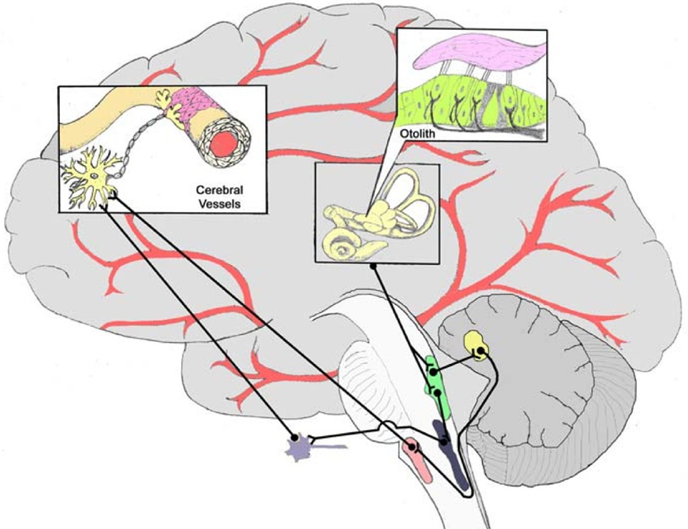
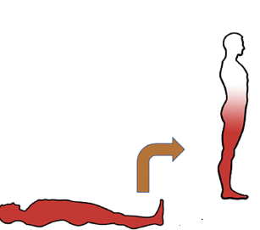
Orthostatic dysfunction and the otoliths
Serrador, J.M., Schlegel, T.T., Black, F.O. et al. Vestibular effects on cerebral blood flow. BMC Neurosci 10, 119 (2009)
Notes:
Standing up leads to pooling of blood in the legs and abdomen, requiring countermeasures
to return blood to the heart for continued cardiac output and cerebral perfusion. Failure of these mechanisms leads to lightheadedness, dizziness, and syncope
Baroreceptors are the most recognized mechanism to counteract this effect; however, the response time is long (> 1 s). Additional information regarding translational acceleration (i.e., standing up) can be transmitted quickly through the vestibular reflex system within 50–100 ms to initiate a sympathetic response. As such, the baroreceptors and otolith reflexes work together to overcome blood pressure fluctuations associated with orthostatic challenge.

Slide 38
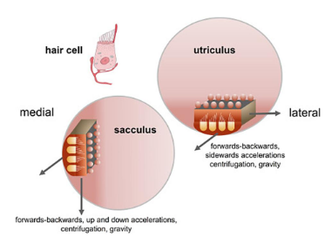
Vestibular dysfunction and orthostatic problems
Orthostatic dizziness:
abnormal otolith reflex responses in 43%
the majority demonstrating reduced or absent responses
Bogle JM The role of otolith reflexes in orthostatic intolerance. Clin Auton Res. 2022 Dec;32(6):395-398
Smith PF (2019) The Growing Evidence for the Importance of the Otoliths in Spatial Memory. Front. Neural Circuits 13:66

Slide 39
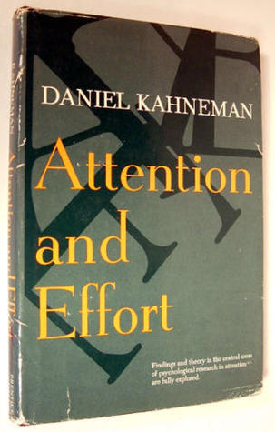
Vestibular dysfunction and cognition
Resource allocation
Blood circulation
Direct connections
Lacroix E, Deggouj N, Edwards MG, Van Cutsem J, Van Puyvelde M, Pattyn N. The Cognitive-Vestibular Compensation Hypothesis: How Cognitive Impairments Might Be the Cost of Coping With Compensation. Front Hum Neurosci. 2021 Oct 1;15:732974
Notes:
Increased gaze and postural instability linked to vestibular loss may demand an elevated allocation of attentional resources for balance maintenance, leading to a reduction in resources available for cognitive tasks.

Slide 40
Vestibular dysfunction and cognition
Self-motion perception
Bodily self-awareness
Smith LJ, Wilkinson D, Bodani M, Surenthiran SS. Cognition in vestibular disorders: state of the field, challenges, and priorities for the future. Front Neurol. 2024 Jan 18;15:1159174
Božanić Urbančič, N., Battelino, S., & Vozel, D. (2023). Appropriate Vestibular Stimulation in Children and Adolescents—A Prerequisite for Normal Cognitive, Motor Development and Bodily Homeostasis—A Review. Children, 11(1), 2.

Slide 41
Vestibular dysfunction and cognition
60% of humans with vestibular disorders have cognitive deficits
Spatial related:
spatial navigation
spatial learning
spatial memory
mental representation of the world
Smith LJ, Wilkinson D, Bodani M, Surenthiran SS. Cognition in vestibular disorders: state of the field, challenges, and priorities for the future. Front Neurol. 2024 Jan 18;15:1159174
Božanić Urbančič, N., Battelino, S., & Vozel, D. (2023). Appropriate Vestibular Stimulation in Children and Adolescents—A Prerequisite for Normal Cognitive, Motor Development and Bodily Homeostasis—A Review. Children, 11(1), 2.

Slide 42
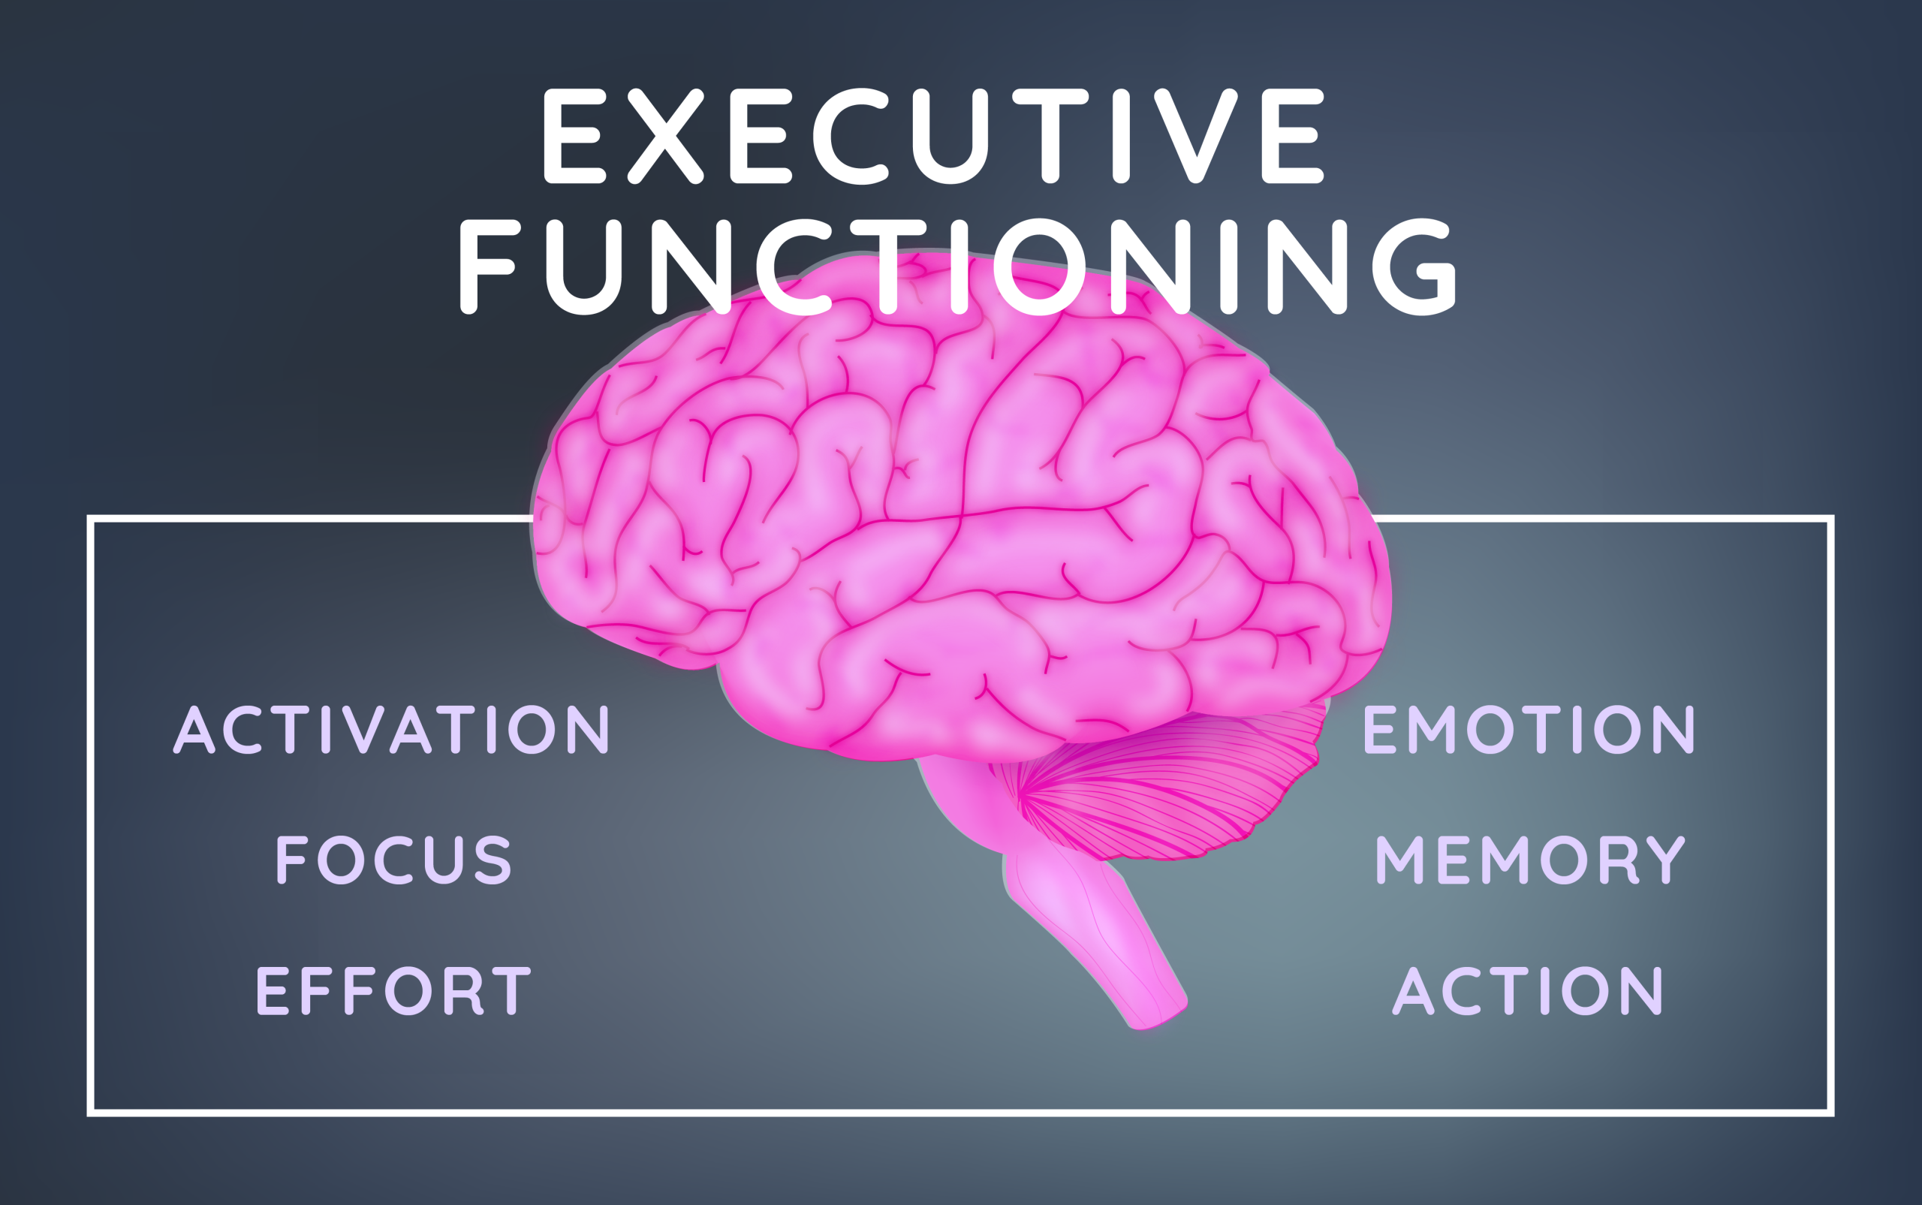
Vestibular dysfunction and cognition
Non-spatial related
Brain fog
Object recognition memory
Concentration problems
Difficulty multitasking
Word-finding problems
Memory issues
Numerical skills issues
Smith LJ, Wilkinson D, Bodani M, Surenthiran SS. Cognition in vestibular disorders: state of the field, challenges, and priorities for the future. Front Neurol. 2024 Jan 18;15:1159174
Božanić Urbančič, N., Battelino, S., & Vozel, D. (2023). Appropriate Vestibular Stimulation in Children and Adolescents—A Prerequisite for Normal Cognitive, Motor Development and Bodily Homeostasis—A Review. Children, 11(1), 2.

Slide 43
Vestibular Influences: Balancing the Brain
In Humans!
Cognitive deficits improve upon vestibular activation
If done asymmetrically in right cortical lesions
Improvement of symptoms by:
Increasing vestibular input on lesioned side
Decreasing input on the contralateral side
De Cicco V, Tramonti Fantozzi MP, Cataldo E, Barresi M, Bruschini L, Faraguna U, Manzoni D. Trigeminal, Visceral and Vestibular Inputs May Improve Cognitive Functions by Acting through the Locus Coeruleus and the Ascending Reticular Activating System: A New Hypothesis. Front Neuroanat. 2018 Jan 8;11:130.
Notes:
Vestibular Influences: Balancing the Brain
Asymmetric labyrinthine activation ameliorates the cognitive deficits induced by lesions of the right parietal cortex and of other brain regions, in humans.
Attenuation of the symptoms was observed by either increasing the afferent vestibular discharge on the lesioned side, or by decreasing it on the contralateral side.
Patients with right cortical damage are unconscious of body parts (asomatognosia) contralateral to the lesion and present spatial (hemi) neglect, i.e., failure to attend and respond to sensory stimuli contralateral to the lesion side
These alterations are not only due to the nervous tissue damage, but also to the imbalance in the activity of right and left hemispheres.
It has been observed, in fact, that hemi neglect due to parietal lesions, in animals, ameliorate following a second, symmetric lesion produced in the contralateral hemisphere (Lomber and Payne, 1996).
In other words, two symmetric lesions are less impairing than a unilateral one.
A possible interpretation of these effects of vestibular stimulation is that these afferents exert a tonic control on the excitability of brain structures and that appropriate modulation of their discharge can decrease the inter-hemispheric imbalance, thus attenuating its neurological consequences.

Slide 44
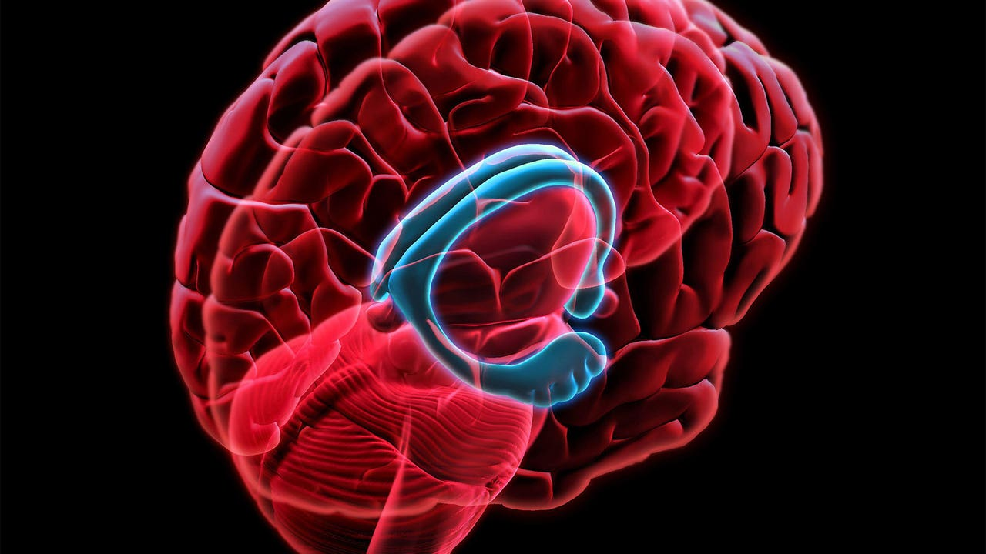
Vestibular dysfunction – long term effects?
Hippocampal atrophy
Anterior hippocampus in particular: AD
Degeneration of the vestibulolimbic/-cortical pathways
Or?
Lack of movement… due to vestibular dysfunction
General age related decline
Not all studies agree
Smith PF. The vestibular system and cognition. Curr Opin Neurol. 2017 Feb;30(1):84-89
Smith PF. Interpreting the meaning of changes in hippocampal volume associated with vestibular loss. Front Integr Neurosci. 2023 Aug 7;17:1254972

Slide 45
Vestibular dysfunction - neurodevelopment
Average child < 6 spends nearly 2 hrs per day on screens in NL
Sedentary lifestyle
Vestibular impaired – cognition impaired
Reflex development:
VOR development: should be fully present at 10 months o.a.
VSR and VCR developmental finetuning approx. 15 y.o.a.
Notes:
impaired subjects also have cognitive deficits. The question is whether the lack of vestibular
stimulation could have similar consequences [17].
We wanted to emphasize that a sedentary lifestyle, becoming common among children
and adolescents in the contemporary world [18], is not only harmful for the metabolic
aspect of their health [19] but could interfere with critical periods and have an influence
on motor development and central vestibular connections and impact cognitive functions.
Moreover, it could cause changes in genetic material that could be passed from generation
to generation

Slide 46
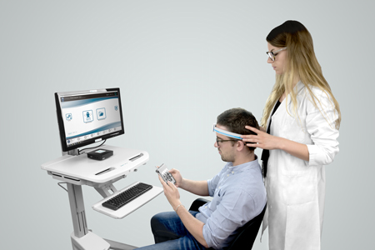
Vestibular dysfunction and neurodevelopment
The functional Head Impulse Test:
Tests VOR functionality
Children with either ASD, ADHD or reading impairment
Neurotypical children
fHIT – a potential biomarker for Neurodevelopmental Disorders?
Caldani S, Baghdadi M, Moscoso A, Acquaviva E, Gerard CL, Marcelli V, Peyre H, Atzori P, Delorme R, Bucci MP. Vestibular Functioning in Children with Neurodevelopmental Disorders Using the Functional Head Impulse Test. Brain Sci. 2020 Nov 20;10(11):887.

Slide 47
Vestibular dysfunction - in psychiatry?
Vestibular dysfunction:
Altered perception of self-posture
Altered representation of surrounding environment
Altered movement of self and the surrounding
Anxiety disorders & Depersonalization/derealization disorder
Anxiety: related to SCC and saccular hypofunction
DPDR develops in association with sacculi dysfunction
Elyoseph Z, Geisinger D, Zaltzman R, Gordon CR, Mintz M. How vestibular dysfunction transforms into symptoms of depersonalization and derealization? J Neurol Sci. 2023 Jan 15;444:120530
Elyoseph Z, Geisinger D, Zaltzman R, Hartman TG, Gordon CR, Mintz M. The overarching effects of vestibular deficit: Imbalance, anxiety, and spatial disorientation. J Neurol Sci. 2023 Aug 15;451:120723
Notes:
Depersonalization-derealization disorder occurs when you always or often feel that you're seeing yourself from outside your body or you sense that things around you are not real — or both. Feelings of depersonalization and derealization can be very disturbing. You may feel like you're living in a dream.
Conclusions: DPDR develops in association with sacculi dysfunction, either with or without SSCs dysfunction. Spatial disorientation and anxiety seem to mediate the transformation of vestibular dysfunction into DPDR symptoms. DPDR does not develop in MJD with central vestibular hypofunction but a normal saccular response. We propose a three-step model that describes the development of DPDR symptoms in vestibular patients.

Slide 48
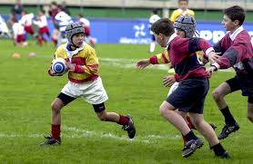
And of course: concussion
Vestibular dysfunction in concussion
Dizziness after concussion in 50-84% of athletes
In paediatric concussed population: 81% demonstrated vestibular dysfunction
In these return to school lasted much longer: 56 days vs. 5 days
Full clearance for activities: 106 days vs. 29 days
Corwin DJ, Wiebe DJ, Zonfrillo MR, Grady MF, Robinson RL, Goodman AM, Master CL. Vestibular Deficits following Youth Concussion. J Pediatr. 2015 May;166(5):1221-5

Slide 49
Use cognitive outcomes measures as well
Trail making tests
Digital symbol substitution test
Simple reaction time
Choice reaction time
Interactive Metronome: timing
Computerized testing of all eye movements

Slide 50
Final remarks
Vestibular assesment can be of great importance for many types of patients
Vestibular dysfunctions are often neglected or misunderstood in musculoskeletal disorders
Vestibular dysfunctions are hardly ever considered in neurological issues
Becoming well-versed in vestibular evaluation and rehabilitation opens opportunities for collaborations with other healthcare professions
So let’s have a look at how to start with this…

Slide 51
Practicum – Vestibular related testing and interventions
Three volunteers with preferably:
Vestibular issues
Oculomotor issues
Balance issues
Post-concussive problems

Slide 52
Oculomotor testing
Convergence
Pursuits – horizontal
Saccades – horizontal
Antisaccades – horizontal
Then we add a vestibular and cervical component to it
Pursuits in 6 positions
Convergence in 6 positions

Slide 53
Balance
Romberg’s test
Eyes open
Eyes closed
Eyes closed with canal challenges

Slide 54
Multisensory testing
Fukuda stepping test
Gait
With dual tasking

Slide 55
Treatment and training
Vestibular ocular rehabilitation (hz/vt/diag)
VOR x 1
VOR x 0
VOR x 2
VOR: vestibular only
Priming of the midbrain
Vertical saccades 30 times
Re-assess convergence

Slide 56
Positional testing & treatment
Dix Hallpike
Supine Roll test
Repositioning manoeuvres:
Epley
Barbecue Roll

Slide 57
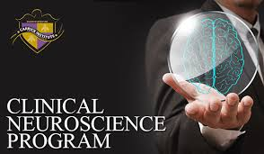
Join us in Amsterdam!
Functional Neurology Bootcamp 7 & 8 September
Functional Neurology Essentials 21-24 November
Start of the 300 hours Clinical Neuroscience Program, early 2025

Slide 58
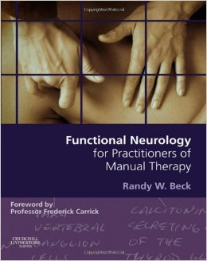
Basic terms and concepts

Slide 59
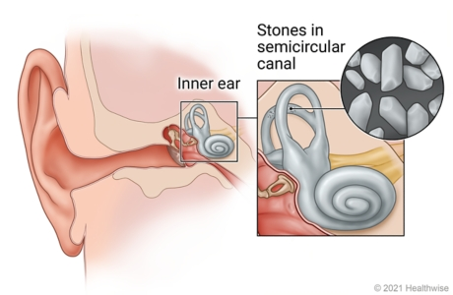
Benign Paroxysmal Postional Vertigo
Loose otoconia
Distorts canal function
Creates real vertigo
Shortlasting
Needs repositioning
Succeeding rate

